Slide 1
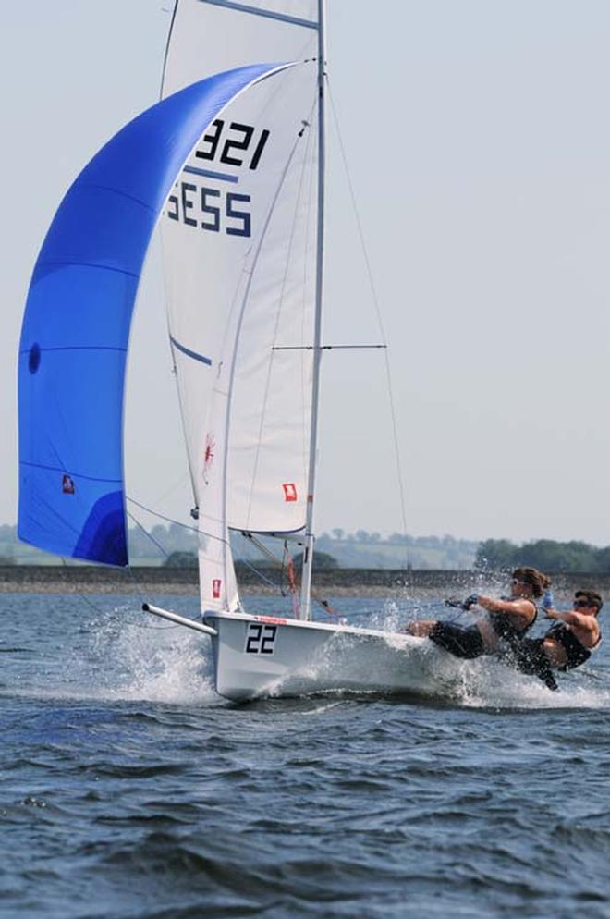
ISA Dinghy/One Design Convention
30th November 2013
ISA Dinghy & One Design Advisory Group

Slide 2
ISA Dinghy/One Design Convention
Welcome
Introductions
Data
Future Data
Development
Cost of Sailing
30th November 2013
ISA Dinghy & One Design Advisory Group

Slide 3
ISA Dinghy/One Design Convention
Introductions:
Margaret O’Donnell (Chair)
Sean Craig
Anthony Shanks
Simon Doran
Kerri-Ann Boylan
David O’Brien
Ed Alcock
30th November 2013
ISA Dinghy & One Design Advisory Group

Slide 4
ISA Dinghy/One Design Convention
National Championship
Annual Turnout Data
Sean Craig
30th November 2013
ISA Dinghy & One Design Advisory Group

Slide 5
Junior Dinghy
Junior Dinghy | Grp | 2004 | 2008 | 2009 | 2010 | 2011 | 2012 | 2013
International Mirror Class | J | 50 | 32 | 30 | 42 | 37 | 30 | 37
International Optimist Dinghy | J | 114 |  | 179 | 161 | 130 | 135 | 133
Irish International 420 Class | J | 17 |  | 15 | 15 | 25 | 16 | 16
Laser 4.7 | J | 33 | 43 | 54 | 40 | 48 | 36 | 38
Laser Radial | J | 57 | 51 | 66 | 43 | 71 | 40 | 58
RS Feva | J |  |  | 25 | 58 | 30 | 21 | 9
Topaz | J |  | 33 | 21 | 24 | 14 | 28 | 12
Topper Class | J | 43 | 63 | 99 | 58 | 62 | 48 | 47
Totals |  | 314 |  | 489 | 441 | 417 | 354 | 350

Slide 6
Senior Dinghy
Senior Dinghy | Grp | 2004 | 2008 | 2009 | 2010 | 2011 | 2012 | 2013
GP14 Class | D | 41 | 34 | 60 | 40 | 47 | 39 | 50
IDRA 14 Class | D | 18 ^{(*)} | 22 | 18 | 28 | 20 | 18 | 17
Irish Fireball | D | 36 | 28 | 28 | 24 | 26 | 20 | 15
Laser Standard | D | 36 | 42 | 38 | 43 | 32 | 42 | 33
Mermaid Sailing | D | 31 | 32 | 30 | 30 | 31 | 40 | 26
Multihull Mixed | D | 33 | 25 | 25 | 14 | 18 | 26 | 20
National 18 Foot Class | D | 24 | 17 | 21 | 20 | 18 | 19 | 16
RS 200 | D | 8 | 7 | 11 | 16 | 13 | 13 | 18
RS 400 | D | 10 | 10 | 15 | 16 | 17 | 14 | 36
Shannon One Design | D | 45 | 26 | 46 | 22 | 34 | 34 | 33
Wayfarer Class | D | 29 | 18 | 15 | 15 | 14 | 14 | 12
Totals |  | 293 | 261 | 307 | 268 | 270 | 279 | 276
(*) Estimate

Slide 7
Keelboat
Keelboat | Grp | 2004 | 2008 | 2009 | 2010 | 2011 | 2012 | 2013
1720 Sportsboat Class | K | 30 | 20 ^{(*)} | 19 | 19 | 17 | 15 | 11
Flying Fifteen | K | 28 | 25 | 30 | 29 | 29 | 23 | 28
Irish Dragon | K | 26 | 16 | 16 | 16 | 17 | 16 | 10
Irish Etchells | K | n/a | 14 | 17 |  | 7 | 7
RS Elite | K | n/a | 14 | 9 | 11 | 11 | 16 | 16
SB-20 | K | n/a | 55 | 47 | 44 | 39 | 22 | 22
Puppeteer Class | K | 17 | 19 | 21 | 20 | 16 | 17 | 14
Ruffian 23 | K | 20 | 22 | 16 | 18 | 20 | 22 | 15
J24 Ireland | K | 29 | 14 | 18 | 17 | 16 | 19 | 16
Squib Class | K | 29 | 28 | 29 | 29 | 32 | 32 | 28
Totals |  | 179 | 207 | 222 | 203 | 204 | 189 | 160
(*) Estimate

Slide 8
Cruiser/Racer
Cruiser/Racer | Grp | 2004 | 2008 | 2009 | 2010 | 2011 | 2012 | 2013
E-Boat Class | C | 12 | 16 | 14 | 17 | 17 | 11 | 10
First 31.7 * | C | 20 |  |  | 12 |  | 15
ICRA 0 | C | 15 | 12 | 6 | 10 | 5 | 10 | 5
ICRA 1 | C | 22 | 27 | 24 | 29 | 14 | 21 | 16
ICRA 2 | C | 34 | 33 | 22 | 29 | 15 | 34 | 11
ICRA 3/4 | C | 21 | 16 | 7 | 16 | 14 | 30 | 10
ICRA NON Spi. (2010+) | C |  |  |  | 25 | 12 | 25 | 10
J-109 | C |  |  | 13 | 8 | 9 | 5 | 9
Shipman * | C |  | 16 |  |  | 13 | 13
Sigma 33 East Coast * | C | 33 |  |  | 14 | 14 | 18
Totals (*excl 31.7, Shipman, Sigma) |  | 104 | 104 | 86 | 134 | 86 | 136 | 71

Slide 9
Nationals Turnouts

Slide 10
Nationals Participation People
Participation People | 2013
Junior Dinghy | 403
Senior Dinghy | 568
Keelboat | 402
Cruiser/Racer | 462
Team & Match Racing | 326
Total | 2161

Slide 11
Nationals Turnouts
Summary points
Senior Dinghy classes ; #Adult Dinghy Decline or “Jewel in the Crown” ? But age profile ?
Junior Dinghy classes ; Transition boats, Single v’s Double Hander
OD Keelboats ; single class distortion, cost factor
Context ; ICRA/Cruisers, “Learn to sail” & club membership trends, recession
Other ; Sailing media, ISA Outreach

Slide 12
ISA Instructor Statistics
Statistics on Instructors
 | Small Boat Sailing Scheme | National Powerboat Training Scheme | Go! Windsurfing Scheme | Emergency Care Training Scheme | National Cruising Scheme | Total Number of Persons on each Course
2003 | 379 | 54 | 54 | 0 | 0 | 487
2004 | 208 | 61 | 49 | 0 | 0 | 318
2005 | 162 | 56 | 61 | 0 | 2 | 281
2006 | 203 | 43 | 55 | 0 | 2 | 303
2007 | 214 | 47 | 45 | 0 | 10 | 316
2008 | 382 | 139 | 40 | 18 | 2 | 581
2009 | 386 | 79 | 47 | 2 | 12 | 526
2010 | 438 | 152 | 65 | 7 | 6 | 668
2011 | 391 | 141 | 73 | 0 | 6 | 611
2012 | 472 | 235 | 48 | 1 | 2 | 758
2013 | 445 | 149 | 51 | 30 | 4 | 679
Total Number of Persons on each Course | 3680 | 1156 | 588 | 58 | 46 | 5528
Notes:
2013 figures are from 1st January to 20th November only
** The number of people attending an Instructor Course, incl. revalidations - Not the number qualified or currently valid.
Within a given year a person may have attended more than one Instructor Course
Figures also include Instructors who attended a Revalidation Workshop

Slide 13
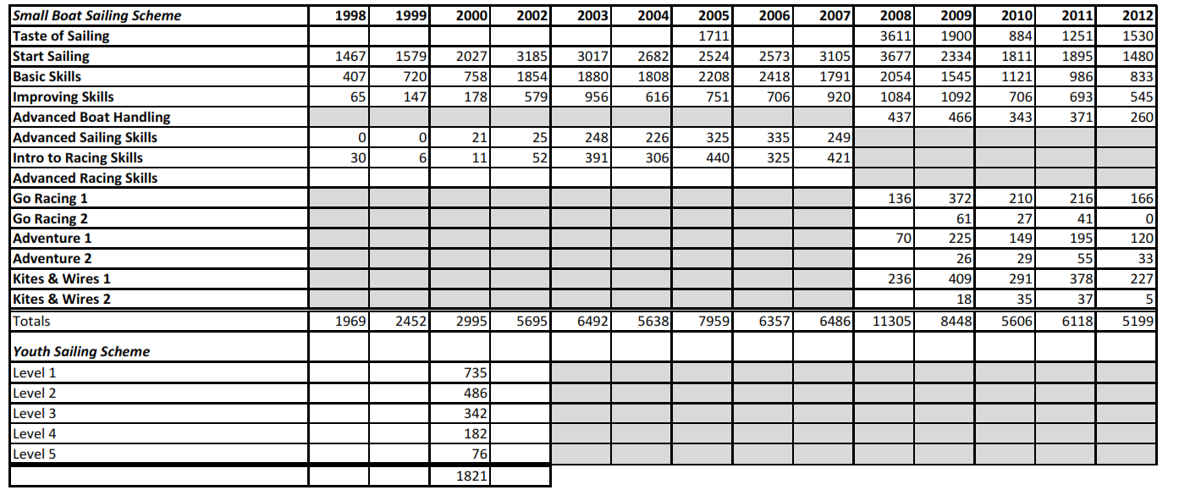
Small Boat Sailing Scheme Certs

Slide 14
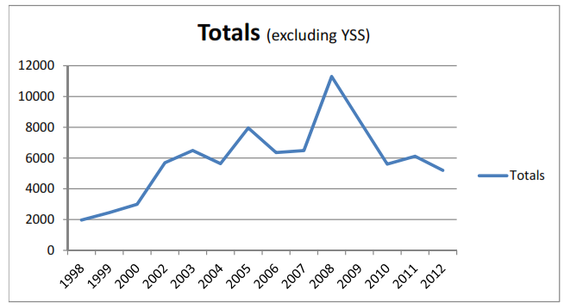
Small Boat Sailing Scheme Certs

Slide 15
Any Questions / Comments?

